Slide 1
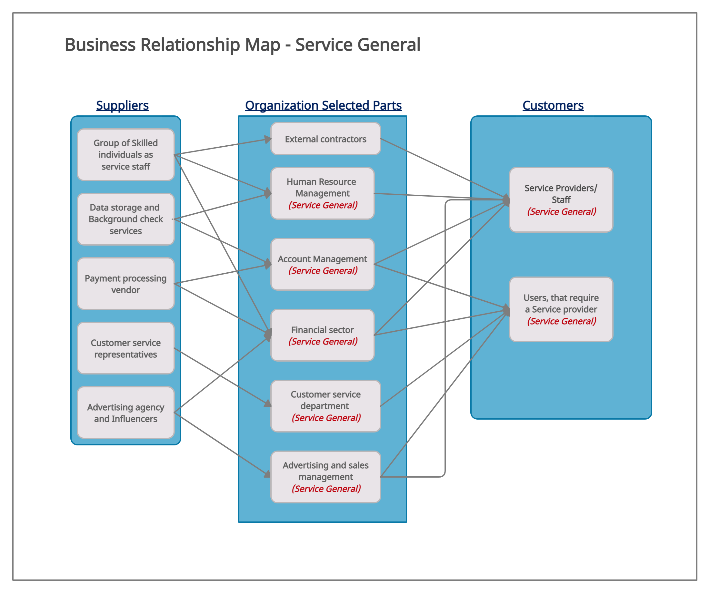

Slide 2
External Users (Customers)
• Service Providers / Staff (Shaina)
• Consumers (Service needers) (Darshan)
Internal Users (Customers)
Business Group | User Roles | Team Member Name
Customer Service Department | Customer Service Representative. | Darshan
Subscription / Account Management | Account Manager | Artsiom
Finance Sector | Accountant | Harrison
Online Ads Marketing | Advertising Expert | Shaina
Maintenance & Enhancements | Tech Specialist | Melba, Tanvi

